Slide 1




OSINT?
The gateway drug your mom never told you about.
Charles Hein Wroth
@AngusRedBlue
Lead Technical Security Recruiter
Notes:
Keynote Benjamin Strick Location Finding and Visual Forensics - A Case Study Presentation

Slide 2
Outline
Introduction: /whoami /ipconfig all
What is OSINT?: What is open-source intelligence?
Why OSINT?: Why conduct OSINT?
The drug: Why it is so awesome?
The highs: The result
The side effects: What can you gain indirectly?
What now?: Feed the supply!
Questions: Hopefully plenty!

Slide 3
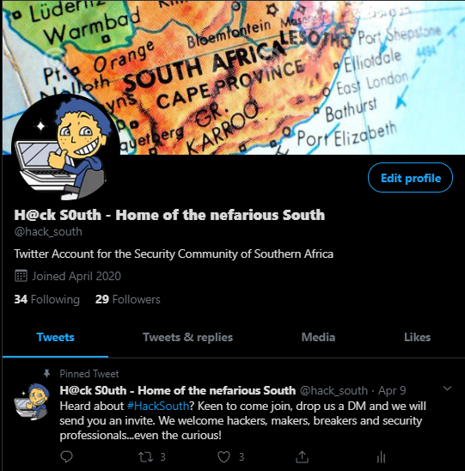
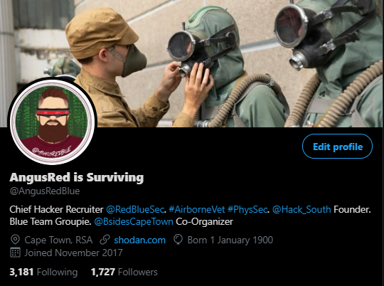
Introduction – $ career/ ls -a
Charles H Wroth – Lead Technical Security Recruiter (USA/EU/UK/RSA)
*6 Years: Former British Airborne (3 PARA) UK
*6 Years :High Risk Security Advisor (PhysSec)
*4 Years: Technical Security Recruiter
-Technically advanced security hiring (USA, UK, RSA)
-B Sides Cape Town Co-Organizer (Logistics)
-Working to become a DFIR Consultant
-Hack South (Founder)
TRACELABS OSINT’er!
Highest ranking P3 (First was 53rd)

Slide 4

What is OSINT

Slide 5
What is OSINT?
Definition
Open-source intelligence (OSINT) is a multi-methods (qualitative, quantitative) methodology for collecting, analyzing and making decision about data accessible in publicly available sources to be used in an intelligence context. In the intelligence community, the term "open" refers to overt, publicly available sources (as opposed to covert or clandestine sources). It is not related to open-source software or collective intelligence.
OSINT under one name or another has been around for hundreds of years. With the advent of instant communications and rapid information transfer, a great deal of actionable and predictive intelligence can now be obtained from public, unclassified sources.

Slide 6
What is OSINT?
Sources:
OSINT sources can be divided up into six different categories of information flow:^{[2]}
Media, print newspapers, magazines, radio, and television from across and between countries.
Internet, online publications, blogs, discussion groups, citizen media (i.e. – cell phone videos, and user created content), YouTube, and other social media websites (i.e. – Facebook, Twitter, Instagram, etc.). This source also outpaces a variety of other sources due to its timeliness and ease of access.
Public Government Data, public government reports, budgets, hearings, telephone directories, press conferences, websites, and speeches. Although this source comes from an official source they are publicly accessible and may be used openly and freely.
Professional and Academic Publications, information acquired from journals, conferences, symposia, academic papers, dissertations, and theses.
Commercial Data, commercial imagery, financial and industrial assessments, and databases.
Grey literature, technical reports, preprints, patents, working papers, business documents, unpublished works, and newsletters.
OSINT is distinguished from research in that it applies the process of intelligence to create tailored knowledge supportive of a specific decision by a specific individual or group.^{[3]}
Notes:
Sources Media Internet (Social Media, blogs, message boards)
Public Gov Data
Academic Publications
Commercial Data
Grey Literature

Slide 7

Why OSINT? What I/we use it for?

Slide 8
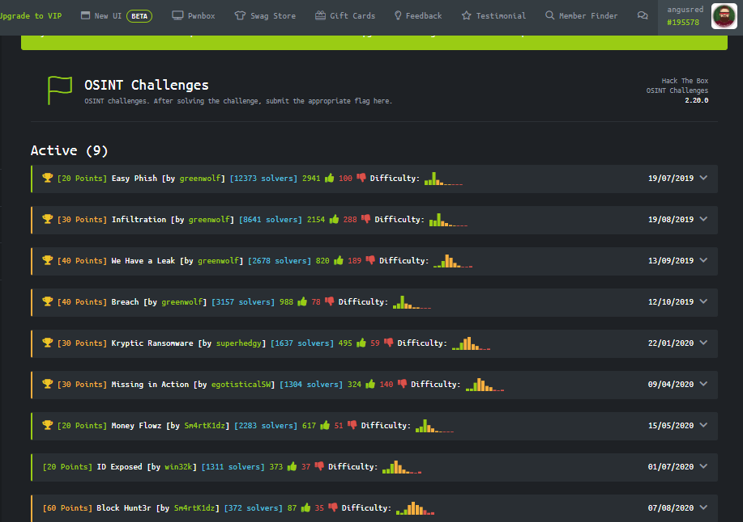
Why OSINT? What I use for?
CTF’s/Challenges
Usually based on fake info/accounts in order to test someone's ability to gather intel and piece it together to form a hypothesis.
Example
Hack The Box Challenges
Personally developed challenges @Bushido
#OSINTchallenge (Finding a location of a photo)
Notes:
END So what does this look like?

Slide 9
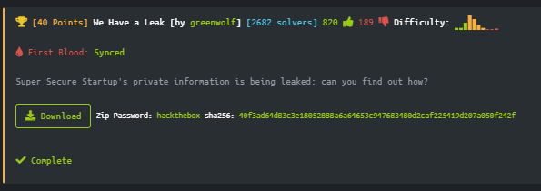
Why OSINT? What I use for?
HTB OSINT Challenges

Slide 10
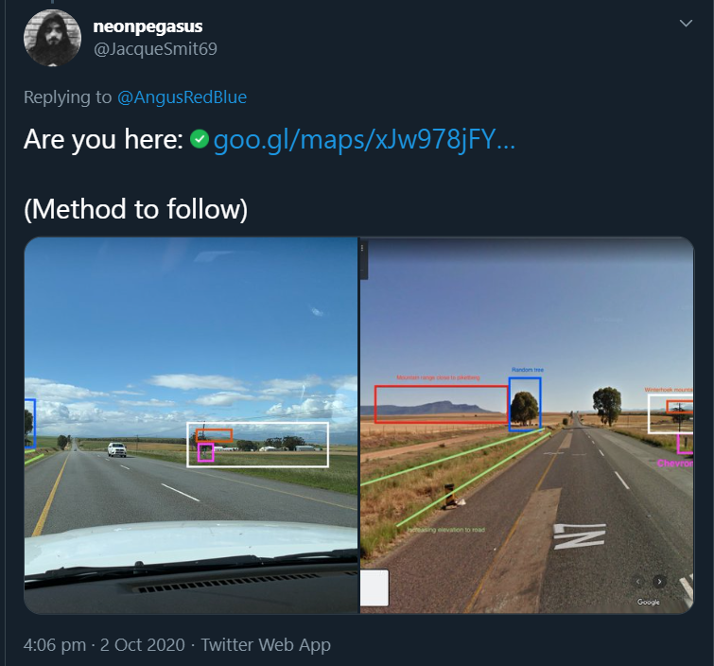
Why OSINT? What I use for?
#OSINTchallenge

Slide 11

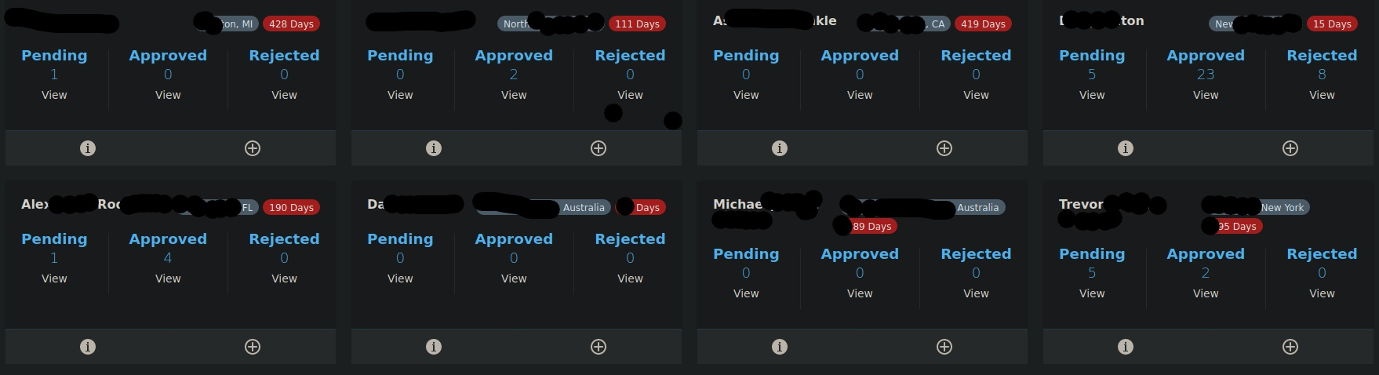
Why OSINT? What I use for?
TraceLabs
A CTF based on 8-12 missing persons cases. It is to challenge someone's ability but is based in real people and real cases and so has a real outcome (Intel passed to law enforcement) in an effort to locate missing person.

Slide 12
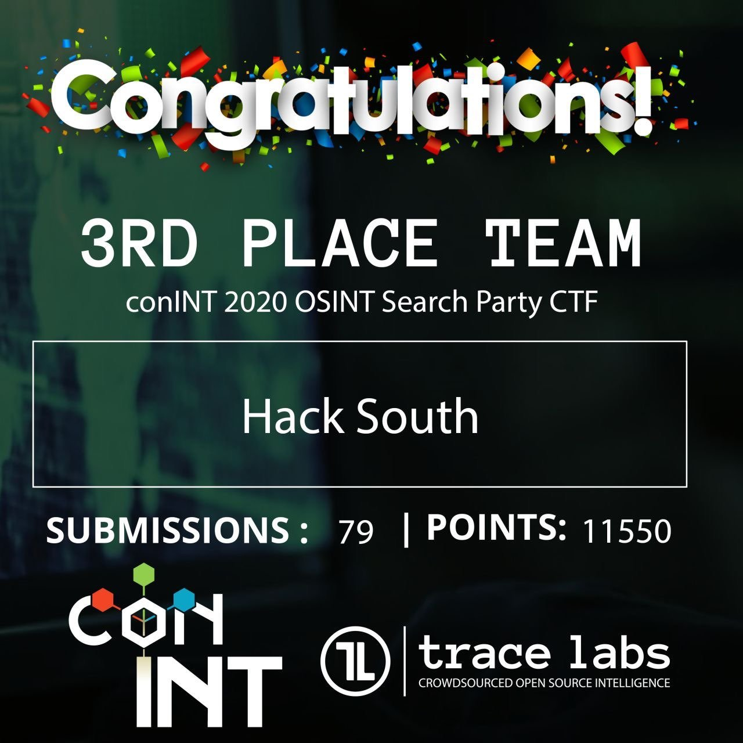

Why OSINT? What I use for?

Slide 13
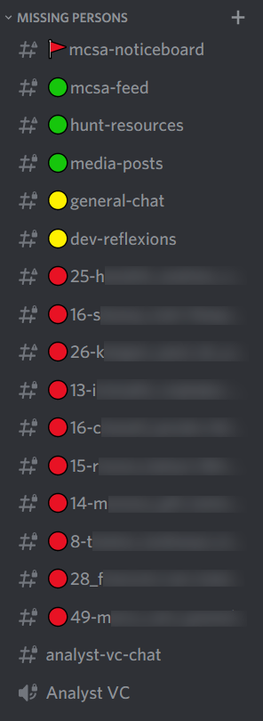


Why OSINT? What I use for?

Slide 14
Why OSINT? What we use it for?
Red Teaming and Social Engineering
Many red teamers will use OSINT to gather intel on proposed targets. They will use that information to build a picture on their clients in order to exploit vulnerabilities, such as with the human factor using Social Engineering and other exploitation tactics.
This often forms part of the recon phase of an engagement.

Slide 15
Why OSINT? What we use it for?
Business Development
As a recruiter I do extensive OSINT to understand my clients or potential clients, what makes them tick and how to string pieces of information together to execute a better pitch to a client.
Example
To get an “in” with companies I will find some people I can talk to
Will conduct basic research on “target” and people I know, know them
Build a picture of the company and people I want to contact
Execute outreach using some basic info to help break ice and build familiarity
Nothing over the top, nothing intrusive

Slide 16
Why OSINT? What we use it for?
Interview Prep
As an interviewee when I was a contractor, I would do extensive research into the company I am interviewing with.
Example
To show my interest in a company I would always do extensive research.
Who am I interviewing with? What is their story? Where did they study?
What does the company do, where do they operate, how do they operate?
On an interview, when asked about what I know about the company, I can show my understanding which holds me in good stead.
I gets the job!

Slide 17
Why OSINT? What we use it for?
Candidate Vetting
As an interviewer or a recruiter I am sometimes asked to do some background checks on candidates.
Using OSINT tactics one can do some basic research into a candidate.
What do they do on the weekends, what does their online presence say about who they are as a person and whether there are any red flags.

Slide 18
Why OSINT? What we use it for?
Police and Military Intelligence
Track down threat actors
Investigate high net worth people (Lifestyles) by SARS
Track down missing children
Track down criminals
Prosecution

Slide 19

The drug Why it is so awesome?

Slide 20
The drug Why it is so awesome?
**Easy of entry**
Prerequisites
A computer/smart phone
Internet
Curiosity
Understanding of ROE
Understanding what you want as an outcome
Understanding of what you might find (Violence, Sex, Nudity, Death)
Notes:
Here we will focus on the complex skills needed to start doing OSINT.
End SEE how simple that is?

Slide 21
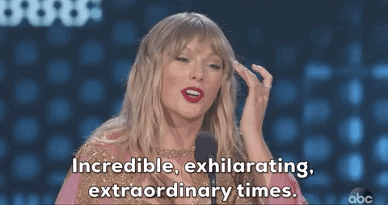
The highs What is the result?

Slide 22
The highs Why it is so awesome? What is the result?
Satisfaction
The find!
The new client, new job
When you know, you know
Many small pieces, make one pretty puzzle
The knowledge
Notes:
The find Finding that last known location of a missing person and reading an article knowing that you were perhaps part of finding that person.
The new client
When your efforts get you that new sweet client
When you know, you know
When you sharpen you abilities, you know what you are able to find. What help you can provide and how to protect yourself, your friends and your family.
Many pieces
With OSINT, one will find small pieces of insignificant information. When you get all these small pieces it builds an interesting picture that is of value.
The knowledge The knowledge of knowing. When you have this skill set, you know what you are able to find, and how to achieve something.

Slide 23

The side effects What can you gain indirectly

Slide 24
The side effects What can you gain indirectly
A champion of OpSec
The hunger
The intent
The path
The career
Notes:
A Champion of OpSec
Being a champion of Operational Security. Being the family OPSEC troll.
The Hunger
You had a taste and want more?
Due to the easy of entry into OSINT, and then achieving some success, it is only natural to want more.
Whether it is more OSINT, whether it is more challenges
The intent
Once achieving the above, one starts to learn more about security and how to find other information (Hacking).
Although the next step is more technically challenging, the hunger and the intent is enough to push into that direction
The path
Once you had the drug, built the hunger and have the intent, people tend to build a path in line with security.
I evolved from OSINT into forensics challenges, into more hacking CTF’s, then STEGO then offensive security, albeit at a slow pace
From there more formal plans evolve into things like pentesting, red teaming, SE or forensics
The career
Now, with everything you have learnt and more, you have added many other skills and you are doing more technical work, but all the while, you are using OSINT in its many forms to add value to your new or evolved career!

Slide 25

What now? Feed the supply

Slide 26
What now? Feed the supply
Going clean?
At least you tried
Better OPSEC/PERSEC awareness
Mindfulness
Remember the good ol days
Notes:
At least you tried.
You gave it a shot, you tried and perhaps it was just not for you and that is cool.
OpSec Awareness
No matter how in depth you got, you learnt something. You learnt to help others protect their OPSEC/PERSEC
Mindfulness
By understanding the risks, and how info can be strung together, you will be better equipped to make better decisions related to what you post and push out to the internet.
Remember
Those were the days. You had fun and will always remember solving certain challenges, solving a case or what you took from it.

Slide 27
What now? Feed the supply
Show and tell
Show your friends and family what OSINT is, what you are able to do, and how that makes them vulnerable.
Understand the ease of entry and get involved!
Get involved with Trace Labs, get involved with other orgs. Take a swing. It can lead to new avenues of interest and potentially a new career in information security.
Evolve into a new career
Walk the path that OSINT takes you. Learn and grow!
Notes:
So you decided to continue down your path with OSINT and didn’t shelve it? Show and Tell
Tell your friends and family about what you do, and how. It will help them take better care when posting certain information.
Understand the entry
Get involved. It took a lot from me to take on a OSINT challenge in HTB, which then lead me to Trace Labs which lead me to more diverse CTF’s. All this has lead me in a direction of career change. **By understanding the ease of entry, you may be more inclined to take your first shot at a challenge or a CTF.
Evolve
Follow the path that OSINT takes you. It might lead to more mindfulness and awareness, or could lead you down a path into Information security.

Slide 28

Takeaway/Summary

Slide 29
Takeaway/Summary
Get involved with OSINT, in whatever form, you are probably doing it already!
Scared? Remind yourself of the easy of entry and take a swing!
Remember the ROE
Tell your friends, family and colleagues about OSINT
Follow the path where OSINT takes you
If you like it, keep learning and evolve your skills
Learn new things

Slide 30
Links and Attribution
Wikipedia: https://en.wikipedia.org/wiki/Open-source_intelligence

Slide 31
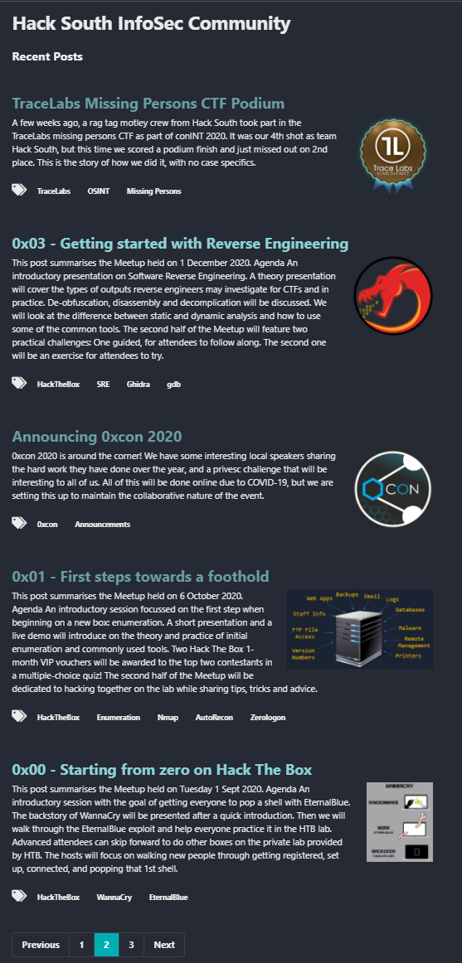

Look us up! Hack South

Slide 32

Look us up! Hack South

Slide 33
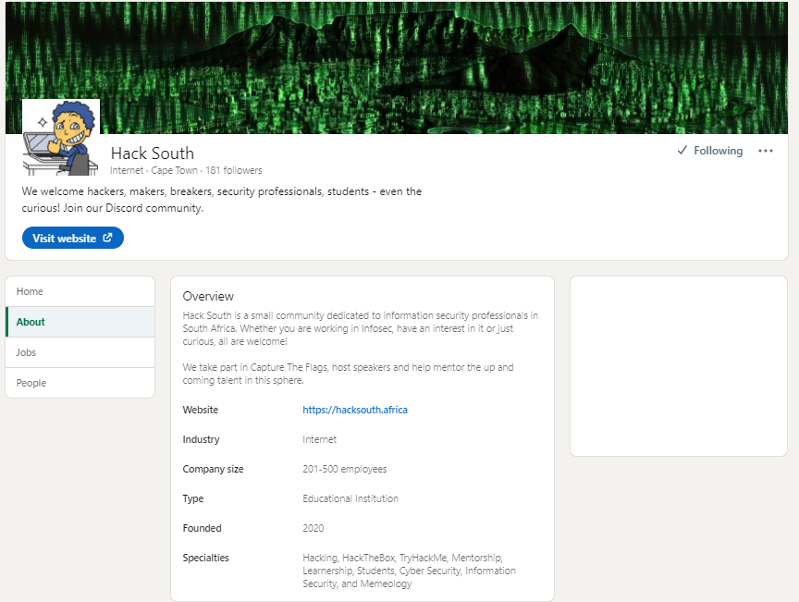
Look us up! Hack South

Slide 34
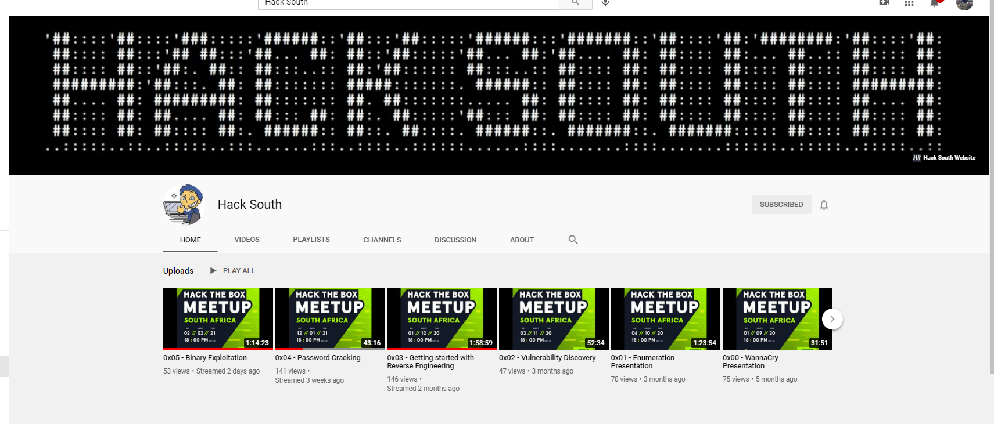
Look us up! Hack South

Slide 35

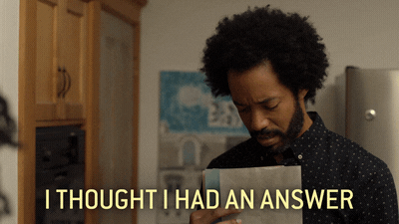
Questions?

Slide 36




@AngusRedBlue
@hack_south
https://github.com/AngusRed
/in/chwroth/
HTB User/195578

